Slide 1
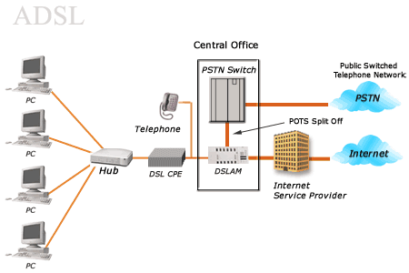
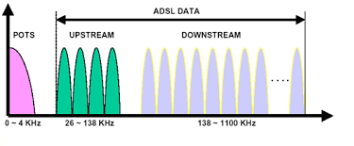
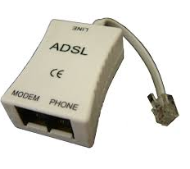
Asymmetric digital subscriber line (ADSL)
Filtro Paso Bajo

Slide 2
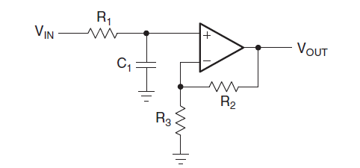
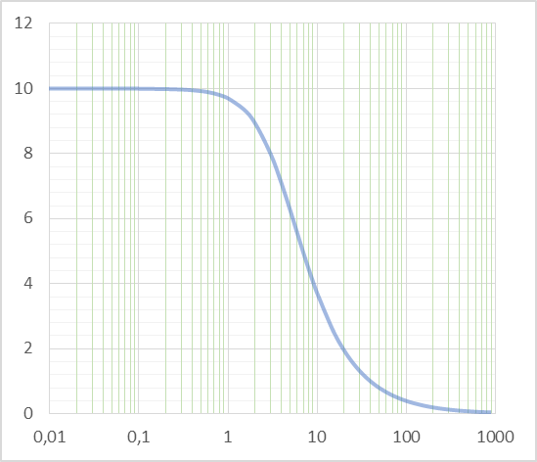
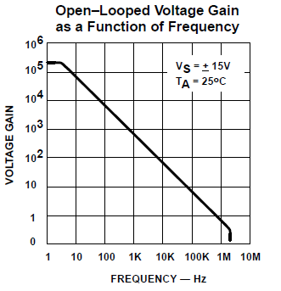

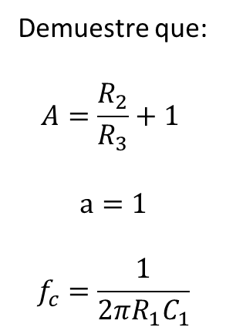
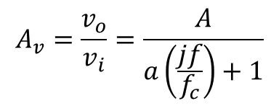
Filtro Paso Bajo de Primer Orden
$$A_{v}=\frac{v_{o}}{v_{i}}=\frac{A}{a\left(\frac{jf}{f_{c}}\right)+1}$$
Demuestre que:
$$A=\frac{R_{2}}{R_{3}}+1$$
$$a=1$$
$$f_{c}=\frac{1}{{2πR}_{1}C_{1}}$$
Filtro Paso Bajo
LM 741
$$4 KHz$$

Slide 3
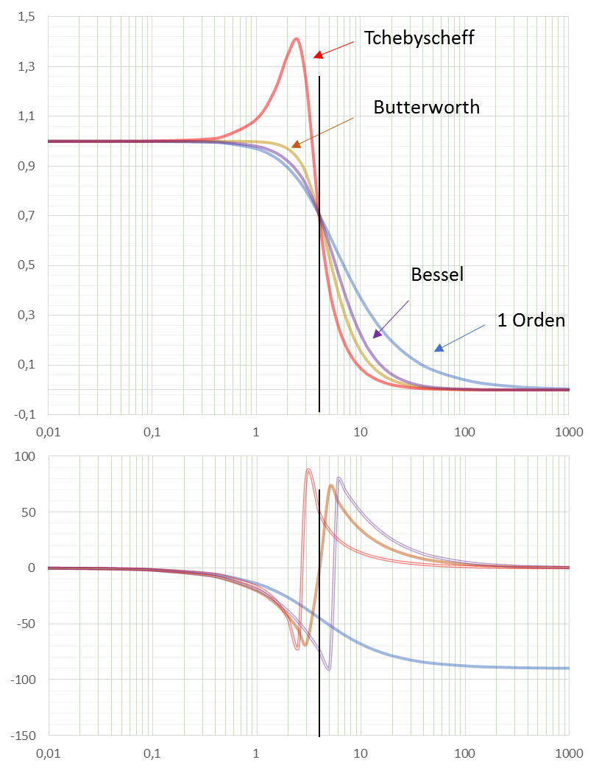
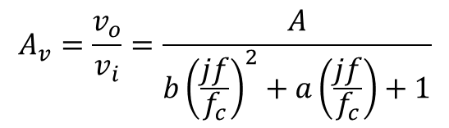
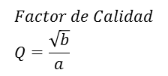
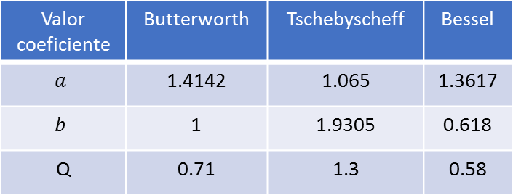
Filtro Paso Bajo de Segundo Orden
$$A_{v}=\frac{v_{o}}{v_{i}}=\frac{A}{b{\left(\frac{jf}{f_{c}}\right)}^{2}+a\left(\frac{jf}{f_{c}}\right)+1}$$
Valor coeficiente | Butterworth | Tschebyscheff | Bessel
$$a$$ | 1.4142 | 1.065 | 1.3617
$$b$$ | 1 | 1.9305 | 0.618
Q | 0.71 | 1.3 | 0.58
$$Factor de Calidad \\ Q=\frac{\sqrt{b}}{a}$$
Filtro Paso Bajo

Slide 4
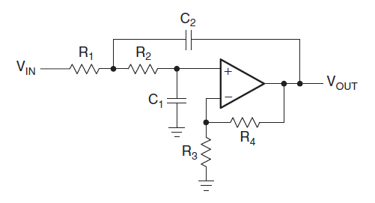


Filtro Paso Bajo de Segundo Orden
Configuración Sallen-Key
$$A_{v}=\frac{v_{o}}{v_{i}}=\frac{A}{b{\left(\frac{jf}{f_{c}}\right)}^{2}+a\left(\frac{jf}{f_{c}}\right)+1}$$
Valor coeficiente | Butterworth | Tschebyscheff | Bessel
$$a$$ | 1.4142 | 1.065 | 1.3617
$$b$$ | 1 | 1.9305 | 0.618
Q | 0.71 | 1.3 | 0.58
Demuestre que si ${R_{2}=R}_{1}=R$ y $C_{1}=C_{2}=C$:
$$A=\frac{R_{4}}{R_{3}}+1$$
$$b={\left(2πf_{c}RC\right)}^{2}$$
$$a=2πf_{c}RC\left(3 −A\right)$$
$$Factor de Calidad \\ Q=\frac{\sqrt{b}}{a}$$
Diseñe el circuito para un Filtro Bessel con $f_{c}=4 KHz$ .
Filtro Paso Bajo

Slide 5
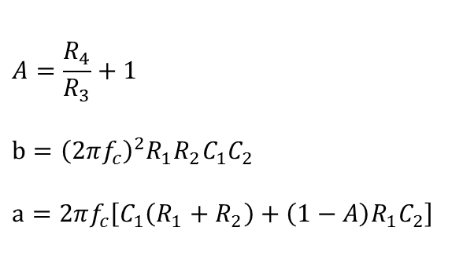
Filtro Paso Bajo de Segundo Orden
Configuración Sallen-Key
$$A_{v}=\frac{v_{o}}{v_{i}}=\frac{A}{b{\left(\frac{jf}{f_{c}}\right)}^{2}+a\left(\frac{jf}{f_{c}}\right)+1}$$
Valor coeficiente | Butterworth | Tschebyscheff | Bessel
$$a$$ | 1.4142 | 1.065 | 1.3617
$$b$$ | 1 | 1.9305 | 0.618
Q | 0.71 | 1.3 | 0.58
$$A=\frac{R_{4}}{R_{3}}+1$$
$$b={\left(2πf_{c}\right)}^{2}R_{1}R_{2}C_{1}C_{2}$$
$$a=2πf_{c}\left[C_{1}\left(R_{1}+R_{2}\right)+\left(1−A\right)R_{1}C_{2}\right]$$
$$Factor de Calidad \\ Q=\frac{\sqrt{b}}{a}$$
Filtro Paso Bajo

Slide 6
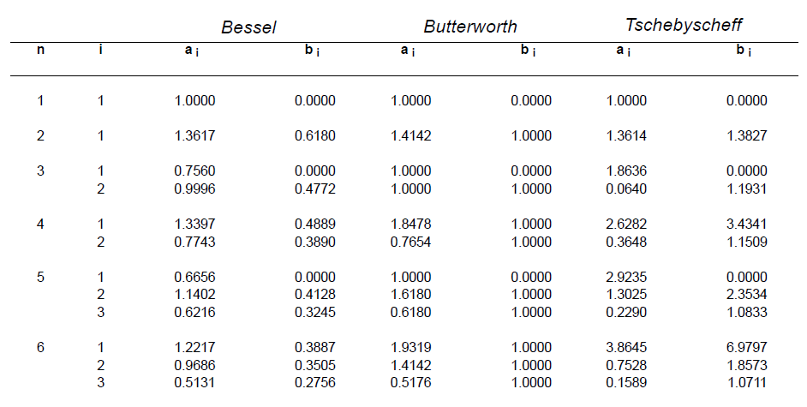
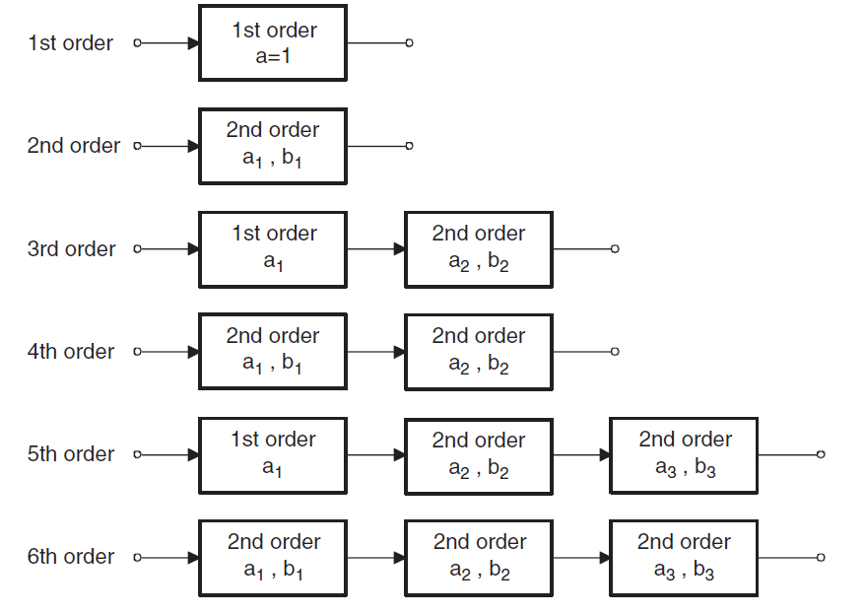
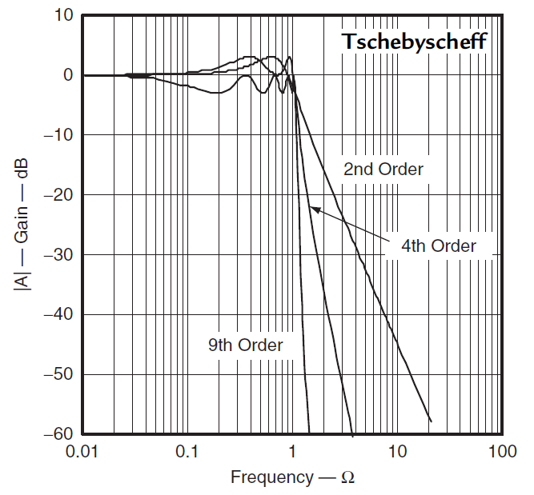
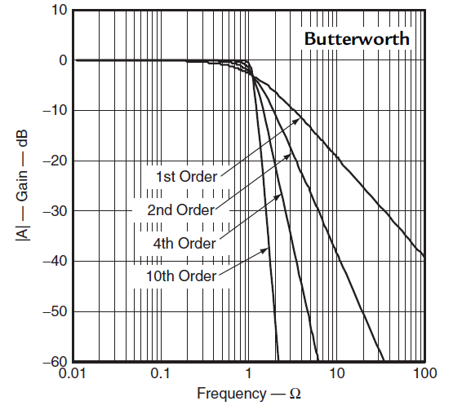

$$Ω=\frac{f}{f_{c}}$$

Slide 7
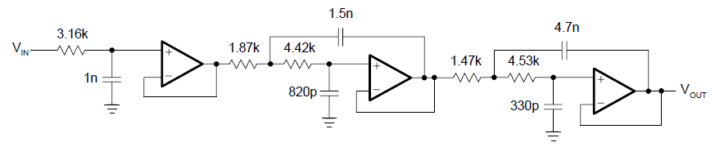
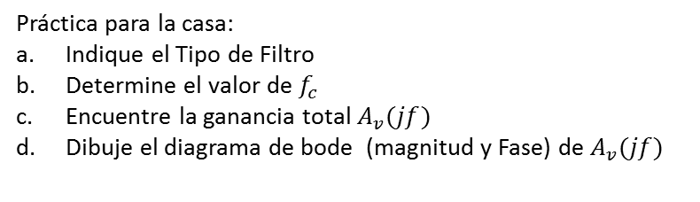

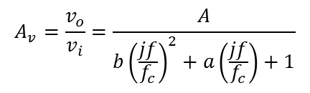
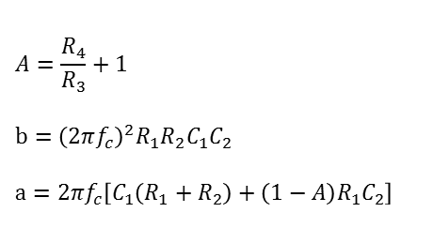
$$A_{v}=\frac{v_{o}}{v_{i}}=\frac{A}{b{\left(\frac{jf}{f_{c}}\right)}^{2}+a\left(\frac{jf}{f_{c}}\right)+1}$$
Configuración Sallen-Key
$$Factor de Calidad \\ Q=\frac{\sqrt{b}}{a}$$
$$A=\frac{R_{4}}{R_{3}}+1$$
$$b={\left(2πf_{c}\right)}^{2}R_{1}R_{2}C_{1}C_{2}$$
$$a=2πf_{c}\left[C_{1}\left(R_{1}+R_{2}\right)+\left(1−A\right)R_{1}C_{2}\right]$$
Práctica para la casa:
Indique el Tipo de Filtro
Determine el valor de $f_{c}$
Encuentre la ganancia total $A_{v}(jf)$
Dibuje el diagrama de bode (magnitud y Fase) de $A_{v}(jf)$

Slide 8
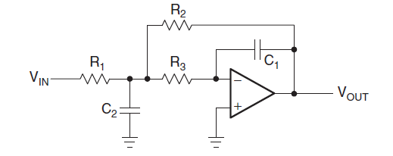
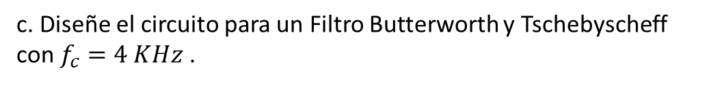
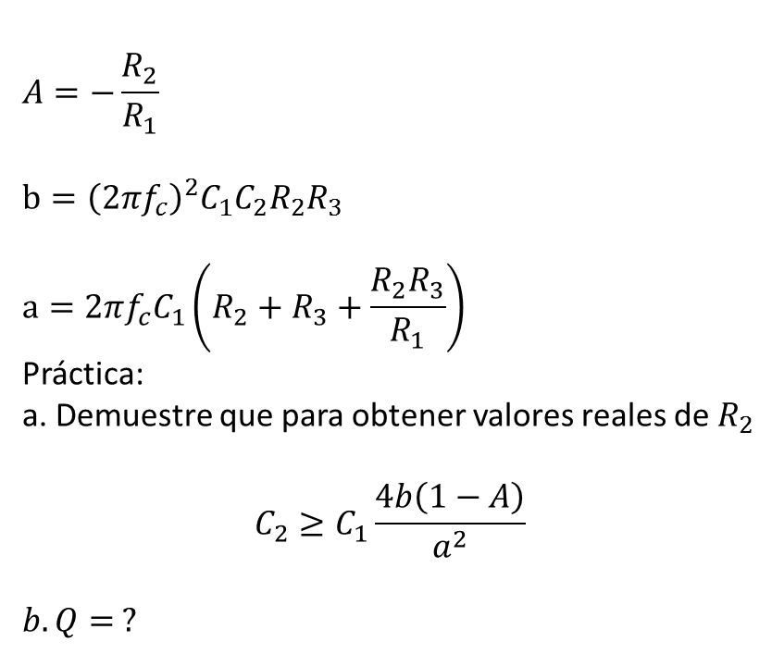
Filtro Paso Bajo de Segundo Orden
Configuración MFB (Multiple Feedback)
$$A_{v}=\frac{v_{o}}{v_{i}}=\frac{A}{b{\left(\frac{jf}{f_{c}}\right)}^{2}+a\left(\frac{jf}{f_{c}}\right)+1}$$
$$A=−\frac{R_{2}}{R_{1}}$$
$$b={\left(2πf_{c}\right)}^{2}C_{1}C_{2}R_{2}R_{3}$$
$$a=2πf_{c}C_{1}\left(R_{2}+R_{3}+\frac{R_{2}R_{3}}{R_{1}}\right)$$
Práctica: a. Demuestre que para obtener valores reales de $R_{2}$
$$C_{2}≥C_{1}\frac{4b\left(1−A\right)}{a^{2}}$$
$$b. Q= ?$$
Valor coeficiente | Butterworth | Tschebyscheff | Bessel
$$a$$ | 1.4142 | 1.065 | 1.3617
$$b$$ | 1 | 1.9305 | 0.618
Q | 0.71 | 1.3 | 0.58
$$Factor de Calidad \\ Q=\frac{\sqrt{b}}{a}$$
c. Diseñe el circuito para un Filtro Butterworth y Tschebyscheff
con $f_{c}=4 KHz$ .
Filtro Paso Bajo

Slide 9
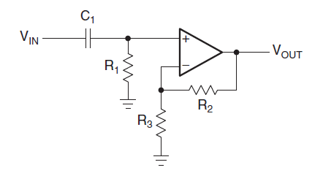
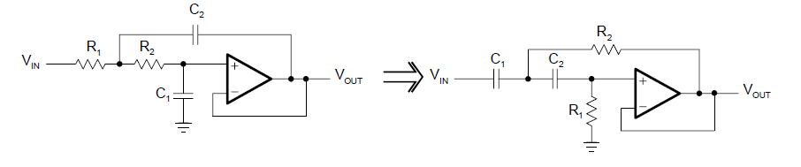

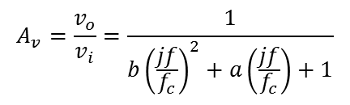
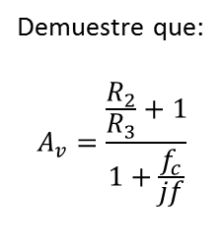

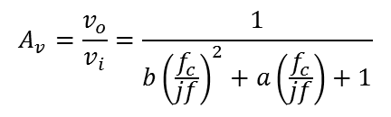
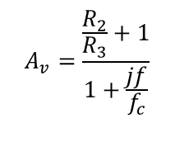
Demuestre que:
$$A_{v}=\frac{\frac{R_{2}}{R_{3}}+1}{1+\frac{f_{c}}{jf}}$$
$$A_{v}=\frac{\frac{R_{2}}{R_{3}}+1}{1+\frac{jf}{f_{c}}}$$
$$f_{c}=\frac{1}{{2πR}_{1}C_{1}}$$
$$⇒$$
Filtro Paso Alto
Paso Bajo
Orden 1
Paso Alto
Orden 1
Filtro Paso Alto
Configuración Sallen-Key
Paso Bajo
Orden 2
Paso Bajo
Orden 2
$$A_{v}=\frac{v_{o}}{v_{i}}=\frac{1}{b{\left(\frac{jf}{f_{c}}\right)}^{2}+a\left(\frac{jf}{f_{c}}\right)+1}$$
$$A_{v}=\frac{v_{o}}{v_{i}}=\frac{1}{b{\left(\frac{f_{c}}{jf}\right)}^{2}+a\left(\frac{f_{c}}{jf}\right)+1}$$

Slide 10
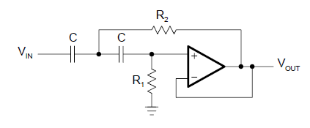
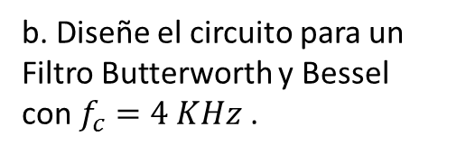
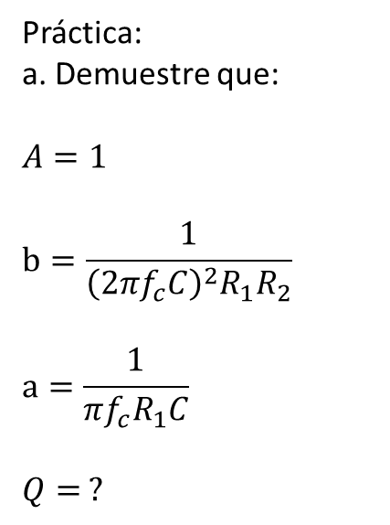
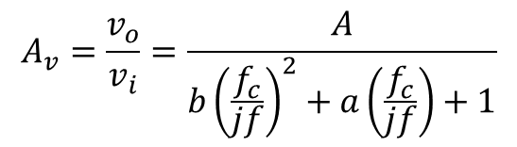
Filtro Paso Alto de Segundo Orden
Configuración Sallen-Key
$$A_{v}=\frac{v_{o}}{v_{i}}=\frac{A}{b{\left(\frac{f_{c}}{jf}\right)}^{2}+a\left(\frac{f_{c}}{jf}\right)+1}$$
Valor coeficiente | Butterworth | Tschebyscheff | Bessel
$$a$$ | 1.4142 | 1.065 | 1.3617
$$b$$ | 1 | 1.9305 | 0.618
Q | 0.71 | 1.3 | 0.58
Práctica: a. Demuestre que:
$$A=1$$
$$b=\frac{1}{{\left(2πf_{c}C\right)}^{2}R_{1}R_{2}}$$
$$a=\frac{1}{πf_{c}R_{1}C}$$
$$Q= ?$$
b. Diseñe el circuito para un Filtro Butterworth y Bessel
con $f_{c}=4 KHz$ .
$$Factor de Calidad \\ Q=\frac{\sqrt{b}}{a}$$
Filtro Paso Alto

Slide 11
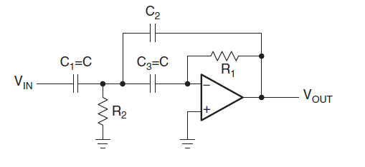
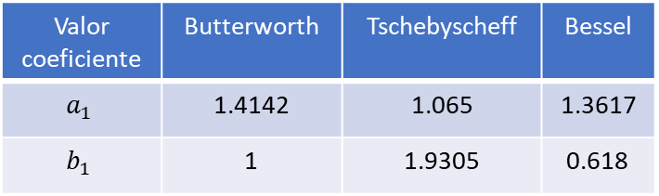
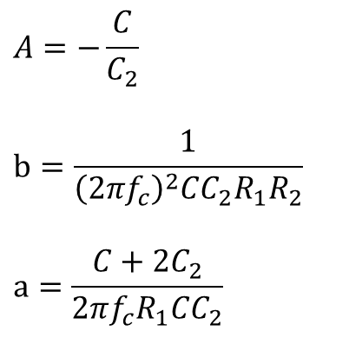
$$A_{v}=\frac{v_{o}}{v_{i}}=\frac{A}{b{\left(\frac{f_{c}}{jf}\right)}^{2}+a\left(\frac{f_{c}}{jf}\right)+1}$$
$$A=−\frac{C}{C_{2}}$$
$$b=\frac{1}{{\left(2πf_{c}\right)}^{2}CC_{2}R_{1}R_{2}}$$
$$a=\frac{C+{2C}_{2}}{2πf_{c}R_{1}CC_{2}}$$
Filtro Paso Alto
Configuración
MFB (Multiple Feedback)
Valor coeficiente | Butterworth | Tschebyscheff | Bessel
$$a_{1}$$ | 1.4142 | 1.065 | 1.3617
$$b_{1}$$ | 1 | 1.9305 | 0.618

Slide 12
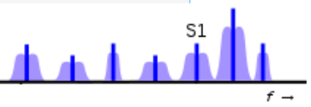
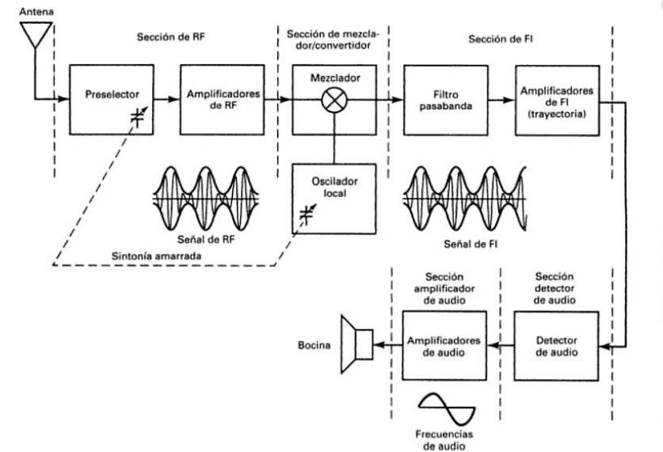

Estaciones de Radio
Sintoniza la estación de radio AM
2395 kHz | 2400 kHz | 2405 kHz
1650 kHz | 1655 kHz | 1660 kHz
740 kHz | 745 kHz | 750 kHz
RF
high-side injection
FI
low-side injection
Receptor AM

Slide 13
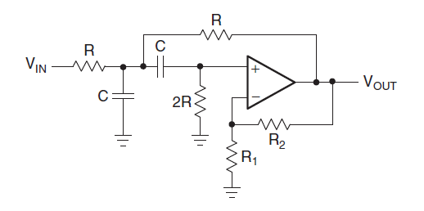








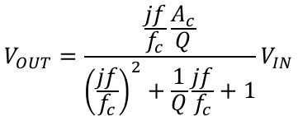

Filtro Pasa Banda
$$Factor de Calidad: Q=\frac{f_{c}}{BW}$$
$$V_{OUT}=\frac{\frac{jf}{f_{c}}\frac{A_{c}}{Q}}{{\left(\frac{jf}{f_{c}}\right)}^{2}+\frac{1}{Q}\frac{jf}{f_{c}}+1}V_{IN}$$
$$A_{c}$$
Configuración
Sallen-Key
$$Q=14.9$$
$$f_{c}=\frac{1}{2πRC}$$
Encontrar los valores de las resistencias y capacitores para una frecuencia media de 745 KHz con un ancho de banda de 50 KHz
$$Q=8.28$$
$G=$ $1+\frac{R_{2}}{R_{1}}$
$$A_{c}=\frac{G}{3−G}$$
$$Q=3.92$$
$$Q=\frac{1}{3−G}$$

Slide 14
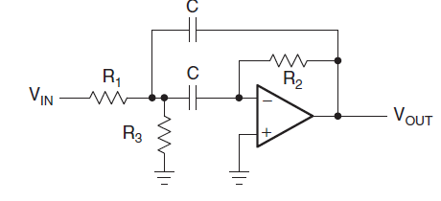
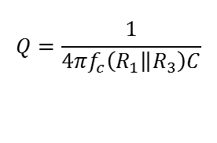

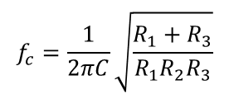
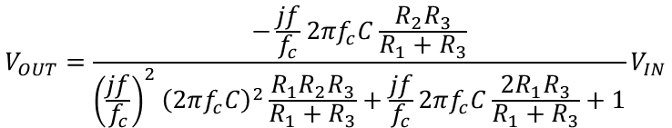

Filtro Pasa Banda
$$Factor de Calidad: Q=\frac{f_{c}}{BW}$$
$$V_{OUT}=\frac{−\frac{jf}{f_{c}}2πf_{c}C\frac{R_{2}R_{3}}{R_{1}+R_{3}}}{{\left(\frac{jf}{f_{c}}\right)}^{2}{\left(2πf_{c}C\right)}^{2}\frac{R_{1}R_{2}R_{3}}{R_{1}+R_{3}}+\frac{jf}{f_{c}}2πf_{c}C\frac{2R_{1}R_{3}}{R_{1}+R_{3}}+1}V_{IN}$$
Diseñe para una ganancia de -25 a la frecuencia media de
745 KHz y un ancho de banda de 50 KHz. Indique el valor de Q.
Configuración
MFB (Multiple Feedback)
$$f_{c}=\frac{1}{2πC}\sqrt{\frac{R_{1}+R_{3}}{R_{1}R_{2}R_{3}}}$$
Sallen-Key
$$A_{c}=−\frac{R_{2}}{2R_{1}}$$
MFB
$$Q=\frac{1}{4πf_{c}\left(R_{1}\left\|R_{3}\right.\right)C}$$

Slide 15
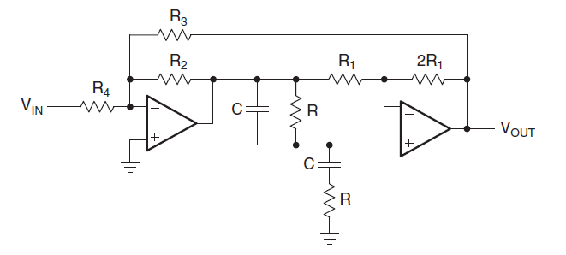
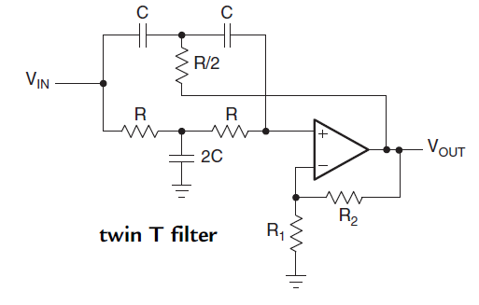










Filtro Rechazo de Banda
$$V_{OUT}=\frac{A\left(1+{\left(\frac{jf}{f_{c}}\right)}^{2}\right)}{{\left(\frac{jf}{f_{c}}\right)}^{2}+\frac{1}{Q}\frac{jf}{f_{c}}+1}V_{IN}$$
$$V_{OUT}=−\frac{\frac{β}{1+α}\left(1+{\left(\frac{jf}{f_{c}}\right)}^{2}\right)}{{\left(\frac{jf}{f_{c}}\right)}^{2}+\frac{3}{1+α}\frac{jf}{f_{c}}+1}V_{IN}$$
$$V_{OUT}=\frac{A\left(1+{\left(\frac{jf}{f_{c}}\right)}^{2}\right)}{{\left(\frac{jf}{f_{c}}\right)}^{2}+2\left(2−A\right)\frac{jf}{f_{c}}+1}V_{IN}$$
$$α=\frac{R_{2}}{R_{3}}$$
$$β=\frac{R_{2}}{R_{4}}$$
$$A=\left(1+\frac{R_{2}}{R_{1}}\right)$$
$$f_{c}=\frac{1}{2πRC}$$
$$A=−\frac{β}{1+α}$$
$$f_{c}=\frac{1}{2πRC}$$
$$Q=\frac{1}{2\left(2−A\right)}$$
$$Q=\frac{1+α}{3}$$
Diseñe para un rechazo de banda con $f_{c}=60 Hz$ y ancho de banda de 5 Hz

Slide 16
740 kHz | 745 kHz | 750 kHz
Estaciones de Radio
Sintoniza la estación de radio AM
2395 kHz | 2400 kHz | 2405 kHz
1650 kHz | 1655 kHz | 1660 kHz
740 kHz | 745 kHz | 750 kHz
RF
high-side injection
FI
low-side injection
Receptor AM

Slide 17







740 kHz | 745 kHz | 750 kHz
cos$\left(2π\left[745kHz\right]t\right)$
cos$\left(2π\left[745kHz\right]t\right)\left[sen\left(2π\left[750kHz\right]t\right)−sen\left(2π\left[740kHz\right]t\right)\right]$=
cos$\left(2π\left[745kHz\right]t\right)sen\left(2π\left[750kHz\right]t\right)−$cos$\left(2π\left[745kHz\right]t\right)sen\left(2π\left[740kHz\right]t\right)=$
AD633
$sen\left(2π\left[1495kHz\right]t\right)$+$sen\left(2π\left[5kHz\right]t\right)−$ $sen\left(2π\left[1485kHz\right]t\right)$+$sen\left(2π\left[5kHz\right]t\right)$=
-$sen\left(2π\left[740kHz\right]t\right)$
$sen\left(2π\left[1495kHz\right]t\right)$ $−$ $sen\left(2π\left[1485kHz\right]t\right)$+ 2$sen\left(2π\left[5kHz\right]t\right)$
$$sen\left(2π\left[750kHz\right]t\right)$$
Diseñe para un filtro paso bajo con $f_{c}=5 KHz$

Slide 18





To make the LM386 a more versatile amplifier, two pins (1 and 8) are provided for gain control. With pins 1 and 8 open the 1.35-kΩ resistor sets the gain at 20 (26 dB). If a capacitor is put from pin 1 to 8, bypassing the 1.35-kΩ resistor, the gain will go up to 200 (46 dB). If a resistor is placed in series with the capacitor, the gain can be set to any value from 20 to 200. Gain control can also be done by capacitively coupling a resistor (or FET) from pin 1 to ground. Additional external components can be placed in parallel with the internal feedback resistors to tailor the gain and frequency response for individual applications. For example, we can compensate poor speaker bass response by frequency shaping the feedback path. This is done with a series RC from pin 1 to 5 (paralleling the internal 15-kΩ resistor). For 6 dB effective bass boost: R ~= 15 kΩ, the lowest value for good stable operation is R = 10 kΩ if pin 8 is open. If pins 1 and 8 are bypassed then R as low as 2 kΩ can be used. This restriction is because the amplifier is only compensated for closed-loop gains greater than 9.
$$sen\left(2π\left[5kHz\right]t\right)$$

